Slide 1

Interpolation

Slide 2
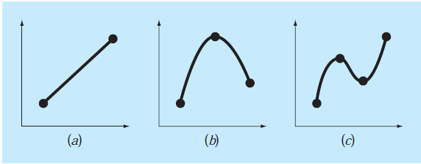
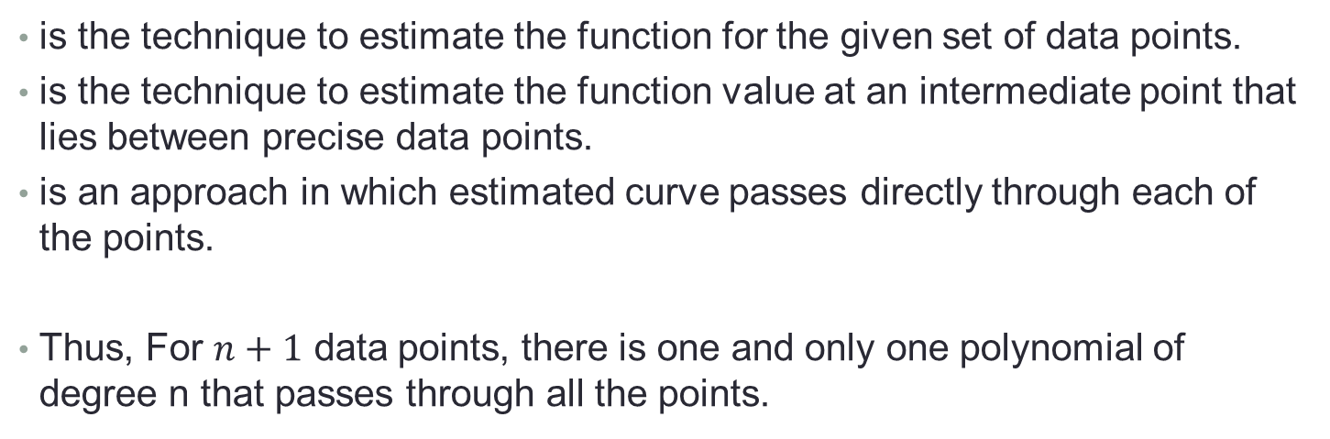
Interpolation:
is the technique to estimate the function for the given set of data points.
is the technique to estimate the function value at an intermediate point that lies between precise data points.
is an approach in which estimated curve passes directly through each of the points.
Thus, For $n+1$ data points, there is one and only one polynomial of degree n that passes through all the points.

Slide 3
There are several Interpolation Techniques.
Lagrange Interpolation Formula
Newton’s Divided Difference Interpolation Formula
Newton’s Forward Difference Interpolation Formula For equally Spaced Data
Cubic Splines
Newton’s Backward Difference Interpolation Formula For equally Spaced Data

Slide 4

Data Types: Equally Spaced and Unequal Spaced Data
Equally spaced data: Values of independent variable are equally spaced. For example if $y=f(x)$ then
x | 1 | 2 | 5
y | 1 | 4 | 10
Unequal Spaced Data
x | 1 | 2 | 3 | 4
y | 0 | 7 | 26 | 124
Equally Spaced Data

Slide 5
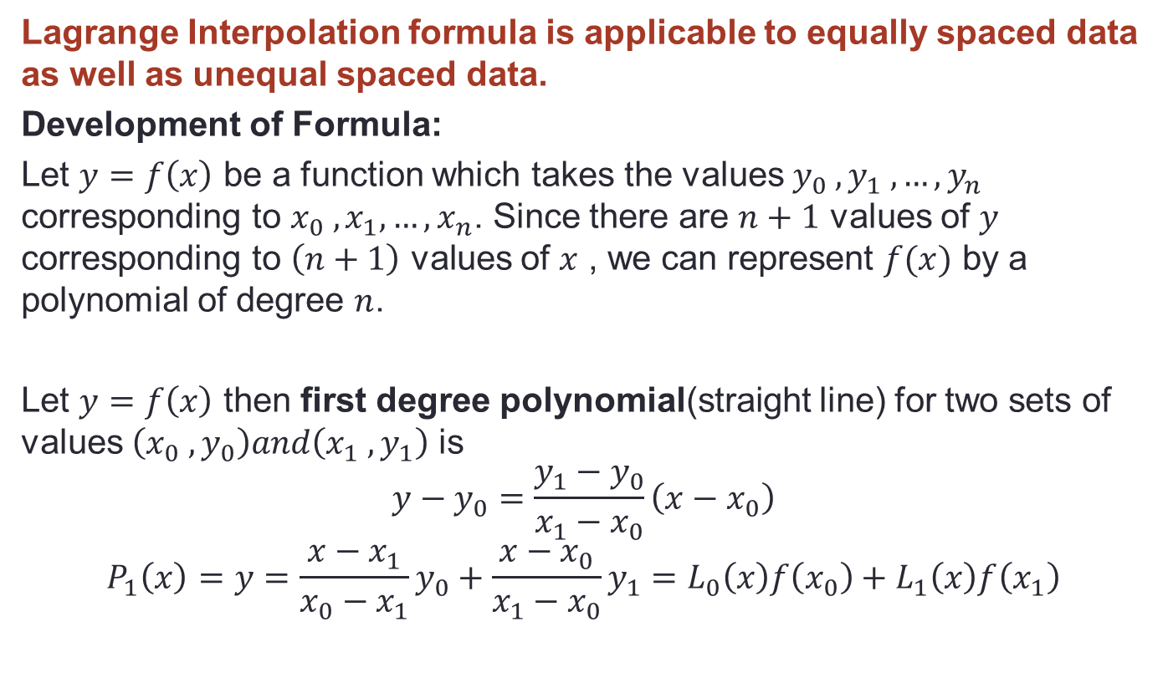
Lagrange Interpolation Formula
Lagrange Interpolation formula is applicable to equally spaced data as well as unequal spaced data.
Development of Formula:
Let $y=f\left(x\right)$ be a function which takes the values $y_{0} ,y_{1} ,…,y_{n}$ corresponding to $x_{0} ,x_{1},…,x_{n}$. Since there are $n+1$ values of $y$ corresponding to $\left(n+1\right)$ values of $x$ , we can represent $f(x)$ by a polynomial of degree $n$.
Let $y=f\left(x\right)$ then first degree polynomial(straight line) for two sets of values $\left(x_{0} , y_{0}\right)and\left(x_{1} , y_{1}\right)$ is
$$y−y_{0}=\frac{y_{1}−y_{0}}{x_{1}−x_{0}}\left(x−x_{0}\right)$$
$$P_{1}\left(x\right)=y=\frac{x−x_{1}}{x_{0}−x_{1}}y_{0}+\frac{x−x_{0}}{x_{1}−x_{0}}y_{1}=L_{0}\left(x\right)f\left(x_{0}\right)+L_{1}\left(x\right)f\left(x_{1}\right)$$

Slide 6
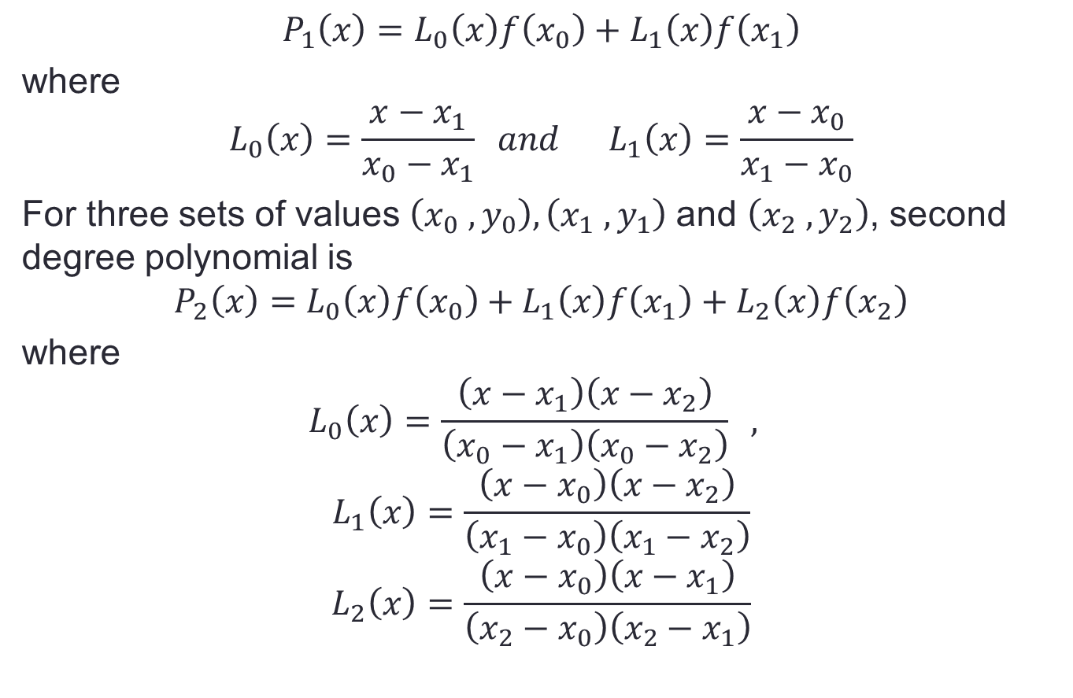
$$P_{1}\left(x\right)=L_{0}\left(x\right)f\left(x_{0}\right)+L_{1}\left(x\right)f\left(x_{1}\right)$$
where
$$L_{0}\left(x\right)=\frac{x−x_{1}}{x_{0}−x_{1}} and L_{1}\left(x\right)=\frac{x−x_{0}}{x_{1}−x_{0}}$$
For three sets of values $\left(x_{0} , y_{0}\right),\left(x_{1} , y_{1}\right)$ and $\left(x_{2} , y_{2}\right)$, second degree polynomial is
$$P_{2}\left(x\right)=L_{0}\left(x\right)f\left(x_{0}\right)+L_{1}\left(x\right)f\left(x_{1}\right)+L_{2}\left(x\right)f\left(x_{2}\right)$$
where
$$L_{0}\left(x\right)=\frac{\left(x−x_{1}\right)\left(x−x_{2}\right)}{\left(x_{0}−x_{1}\right)\left(x_{0}−x_{2}\right)} ,$$
$$L_{1}\left(x\right)=\frac{\left(x−x_{0}\right)\left(x−x_{2}\right)}{\left(x_{1}−x_{0}\right)\left(x_{1}−x_{2}\right)}$$
$$L_{2}\left(x\right)=\frac{\left(x−x_{0}\right)\left(x−x_{1}\right)}{\left(x_{2}−x_{0}\right)\left(x_{2}−x_{1}\right)}$$

Slide 7
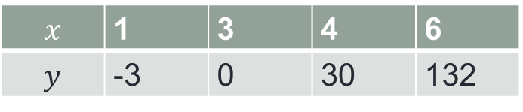
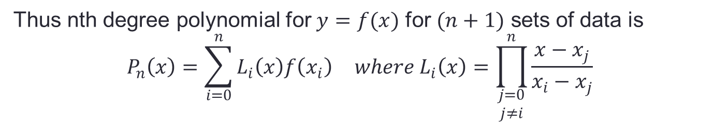
Thus nth degree polynomial for $y=f(x)$ for $(n+1)$ sets of data is
$$P_{n}\left(x\right)=\sum_{i=0}^{n}{L_{i}\left(x\right)f\left(x_{i}\right)} where L_{i}\left(x\right)=\prod_{\begin{aligned}j=0 \\ j≠i\end{aligned}}^{n}{\frac{x−x_{j}}{x_{i}−x_{j}}}$$
Example 1:
Find Lagrange Interpolation polynomial fitting the points given in the following table.
$$x$$ | 1 | 3 | 4 | 6
$$y$$ | -3 | 0 | 30 | 132

Slide 8
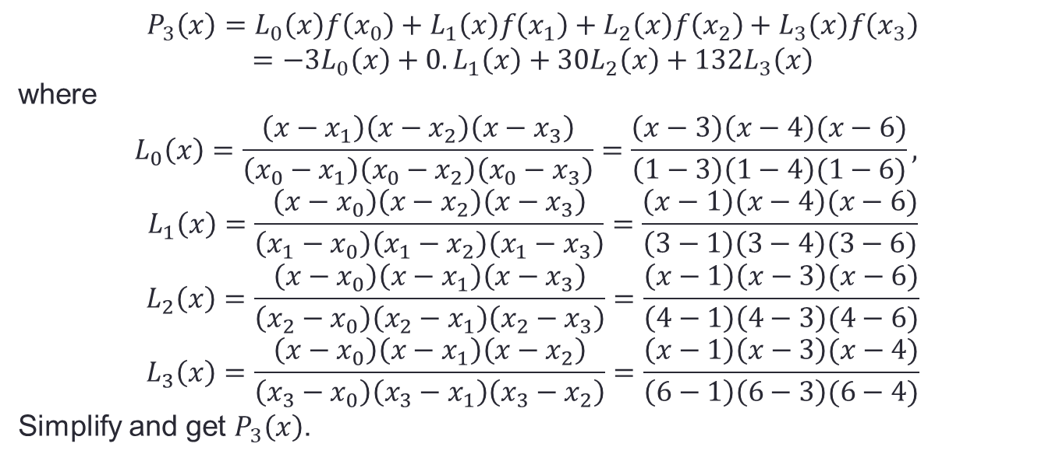
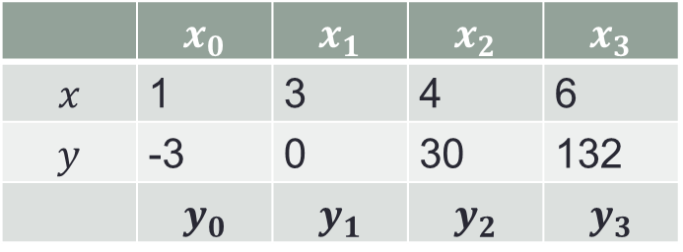
Solution:
 | $$x_{0}$$ | $$x_{1}$$ | $$x_{2}$$ | $$x_{3}$$
$$x$$ | 1 | 3 | 4 | 6
$$y$$ | -3 | 0 | 30 | 132
 | $$y_{0}$$ | $$y_{1}$$ | $$y_{2}$$ | $$y_{3}$$
$$P_{3}\left(x\right)=L_{0}\left(x\right)f\left(x_{0}\right)+L_{1}\left(x\right)f\left(x_{1}\right)+L_{2}\left(x\right)f\left(x_{2}\right)+L_{3}\left(x\right)f\left(x_{3}\right)$$
$$=−3L_{0}\left(x\right)+0.L_{1}\left(x\right)+30L_{2}\left(x\right)+132L_{3}\left(x\right)$$
where
$$L_{0}\left(x\right)=\frac{\left(x−x_{1}\right)\left(x−x_{2}\right)\left(x−x_{3}\right)}{\left(x_{0}−x_{1}\right)\left(x_{0}−x_{2}\right)\left(x_{0}−x_{3}\right)}=\frac{\left(x−3\right)\left(x−4\right)(x−6)}{\left(1−3\right)\left(1−4\right)(1−6)},$$
$$L_{1}\left(x\right)=\frac{\left(x−x_{0}\right)\left(x−x_{2}\right)\left(x−x_{3}\right)}{\left(x_{1}−x_{0}\right)\left(x_{1}−x_{2}\right)\left(x_{1}−x_{3}\right)}=\frac{\left(x−1\right)\left(x−4\right)(x−6)}{\left(3−1\right)\left(3−4\right)(3−6)}$$
$$L_{2}\left(x\right)=\frac{\left(x−x_{0}\right)\left(x−x_{1}\right)\left(x−x_{3}\right)}{\left(x_{2}−x_{0}\right)\left(x_{2}−x_{1}\right)\left(x_{2}−x_{3}\right)}=\frac{\left(x−1\right)\left(x−3\right)(x−6)}{\left(4−1\right)\left(4−3\right)(4−6)}$$
$$L_{3}\left(x\right)=\frac{\left(x−x_{0}\right)\left(x−x_{1}\right)\left(x−x_{2}\right)}{\left(x_{3}−x_{0}\right)\left(x_{3}−x_{1}\right)\left(x_{3}−x_{2}\right)}=\frac{\left(x−1\right)\left(x−3\right)(x−4)}{\left(6−1\right)\left(6−3\right)(6−4)}$$
Simplify and get $P_{3}\left(x\right)$.

Slide 9
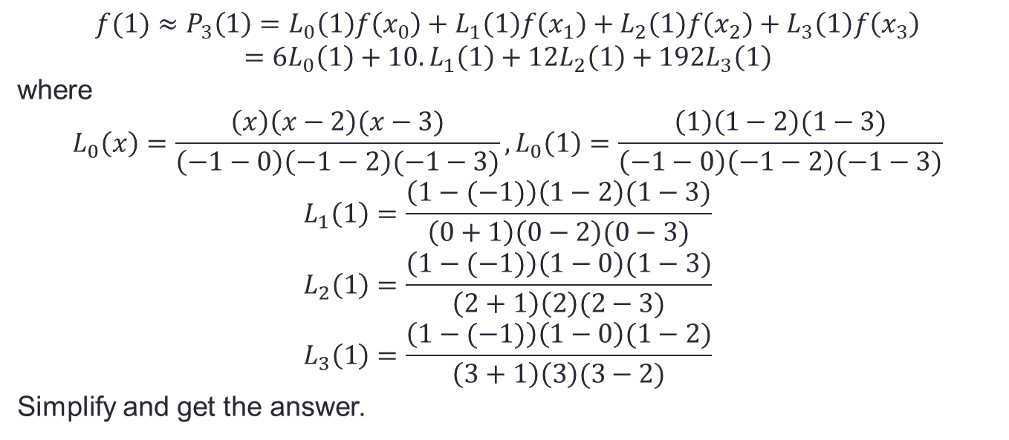

Example 2:
Find $f(x)$ at $x=1$ from the following table using Lagrange’s formula.
x | -1 | 0 | 2 | 3
y | 6 | 10 | 12 | 19
Solution:
$$f(1)≈P_{3}\left(1\right)=L_{0}\left(1\right)f\left(x_{0}\right)+L_{1}\left(1\right)f\left(x_{1}\right)+L_{2}\left(1\right)f\left(x_{2}\right)+L_{3}\left(1\right)f\left(x_{3}\right)$$
$$=6L_{0}\left(1\right)+10.L_{1}\left(1\right)+12L_{2}\left(1\right)+192L_{3}\left(1\right)$$
where
$$L_{0}\left(x\right)=\frac{\left(x\right)\left(x−2\right)(x−3)}{\left(−1−0\right)\left(−1−2\right)(−1−3)}, L_{0}\left(1\right)=\frac{\left(1\right)\left(1−2\right)(1−3)}{\left(−1−0\right)\left(−1−2\right)(−1−3)}$$
$$L_{1}\left(1\right)=\frac{\left(1−(−1)\right)\left(1−2\right)(1−3)}{\left(0+1\right)\left(0−2\right)(0−3)}$$
$$L_{2}\left(1\right)=\frac{\left(1−(−1)\right)\left(1−0\right)(1−3)}{\left(2+1\right)\left(2\right)(2−3)}$$
$$L_{3}\left(1\right)=\frac{\left(1−(−1)\right)\left(1−0\right)(1−2)}{\left(3+1\right)\left(3\right)(3−2)}$$
Simplify and get the answer.

